Slide 1

WEEKLY #3 PRESENTATION
Pre class DumbWays Batch-28
http://www.free-powerpoint-templates-design.com

Slide 2
Presentation Point
01
Database MySQL
Data Definition Language (DDL), Data Manipulation Language (DML), Relational Database
02
HOF and Callback
03
Asynchronous

Slide 3
Database MySQL

Slide 4
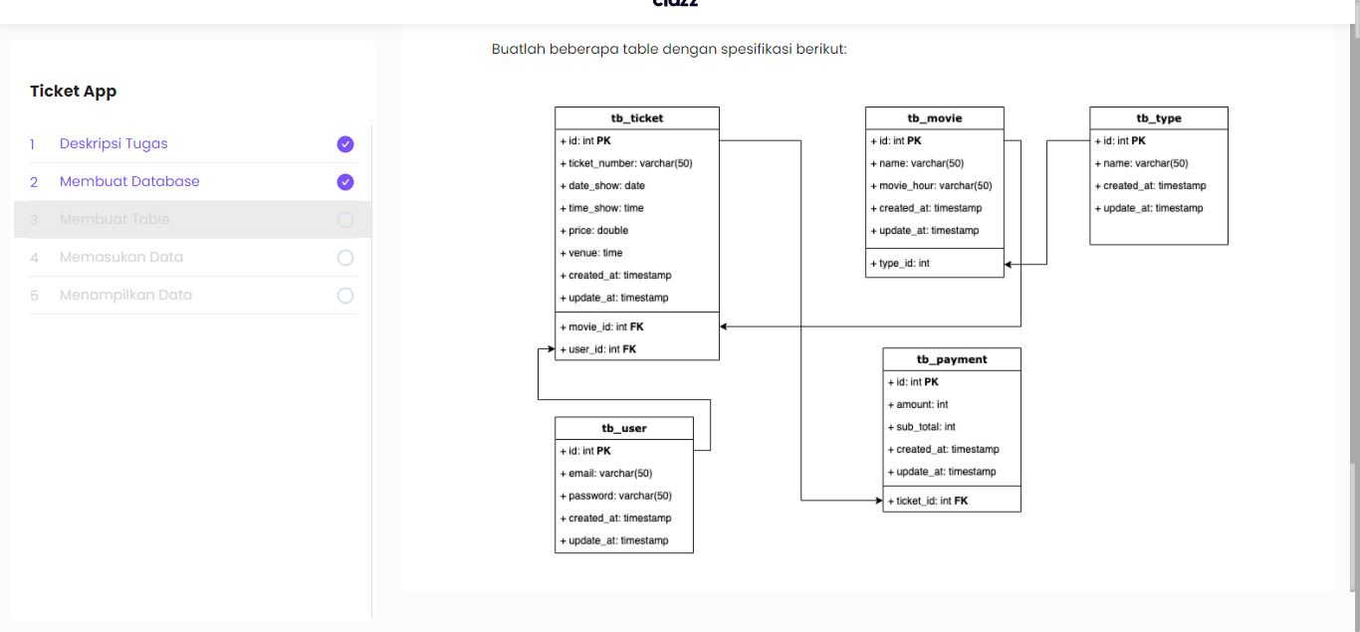

Slide 5
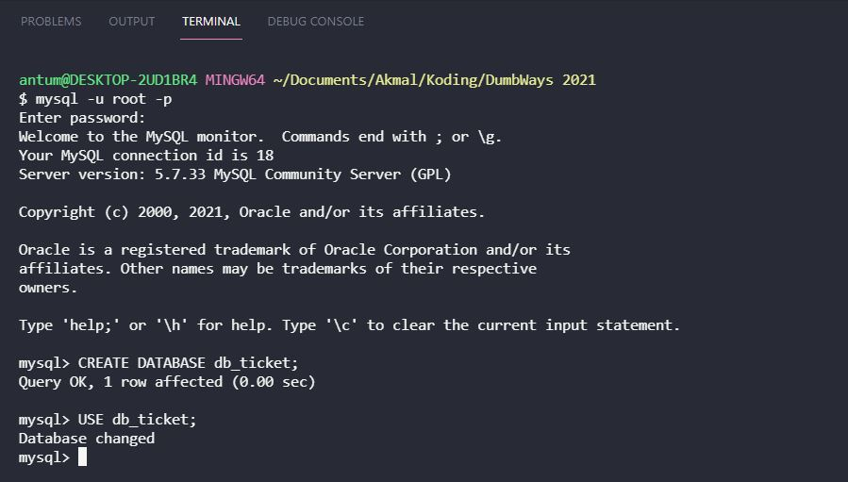
Create and use database

Slide 6
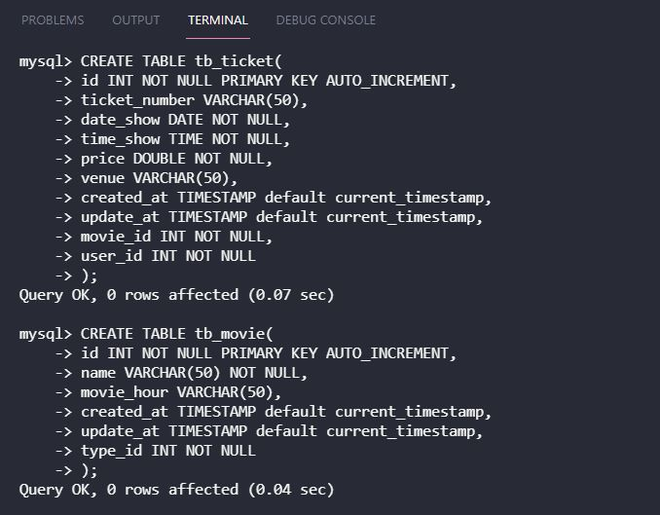
Create table

Slide 7
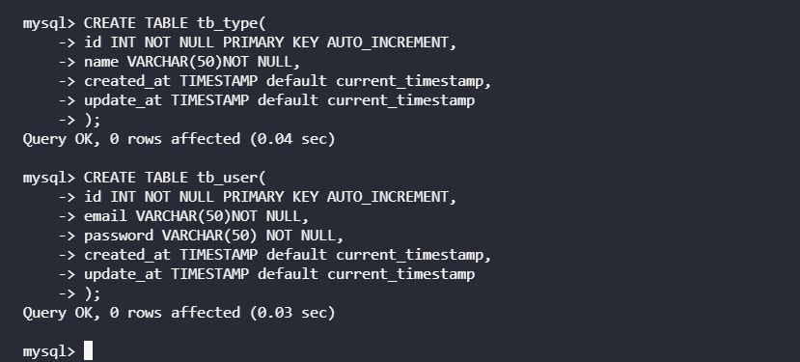
Create table (2)

Slide 8
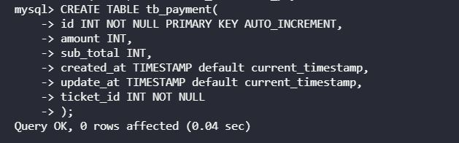
Create table (3)

Slide 9
Insert

Slide 10
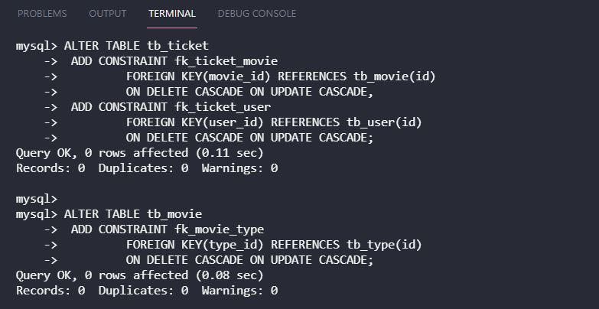
Relation

Slide 11
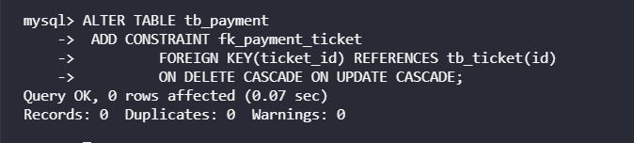
Relation (2)

Slide 12
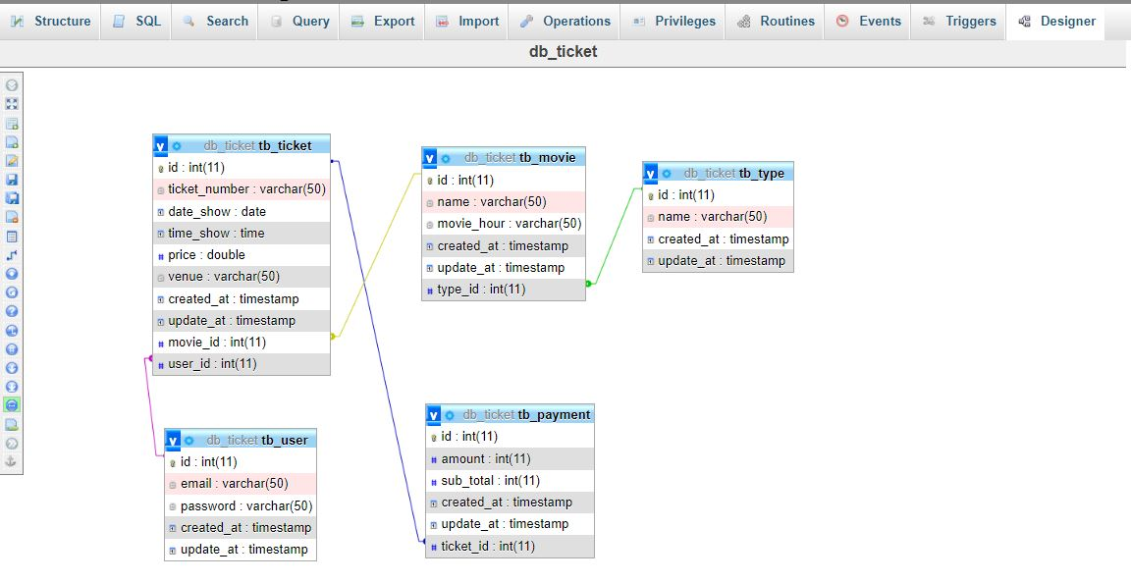

Slide 13
HOF and Callback

Slide 14
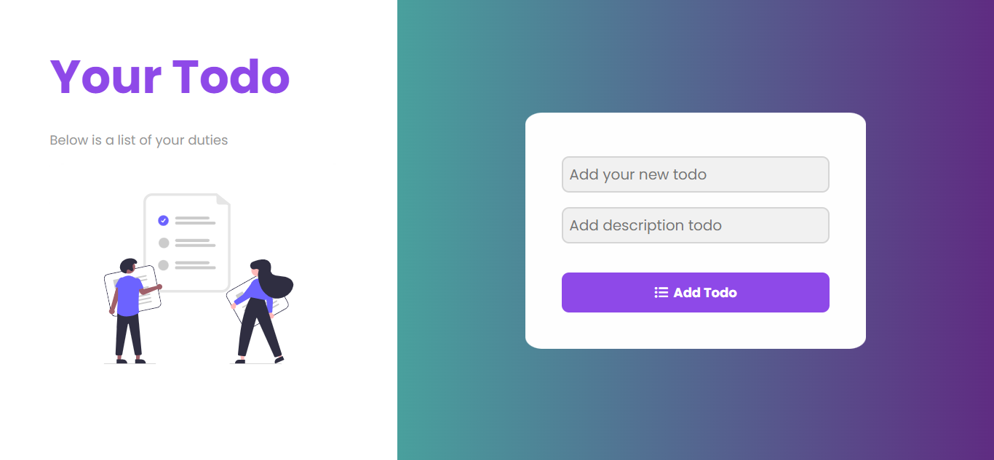
Welcome!!
Insert the title of your subtitle Here
This PowerPoint Template has clean and neutral design that can be adapted to any content and meets various market segments.

Slide 15
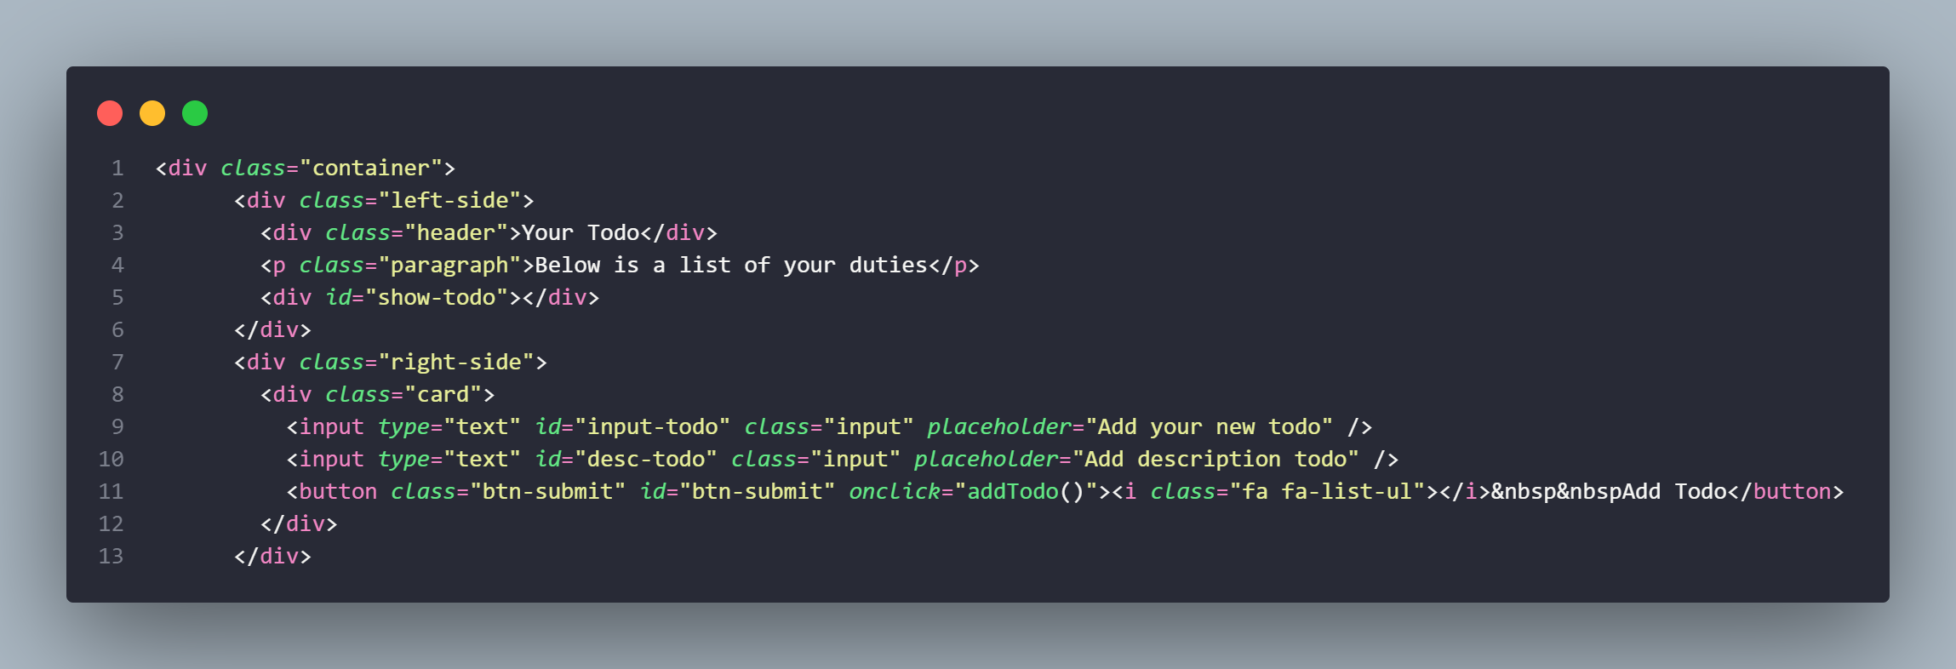
HTML

Slide 16
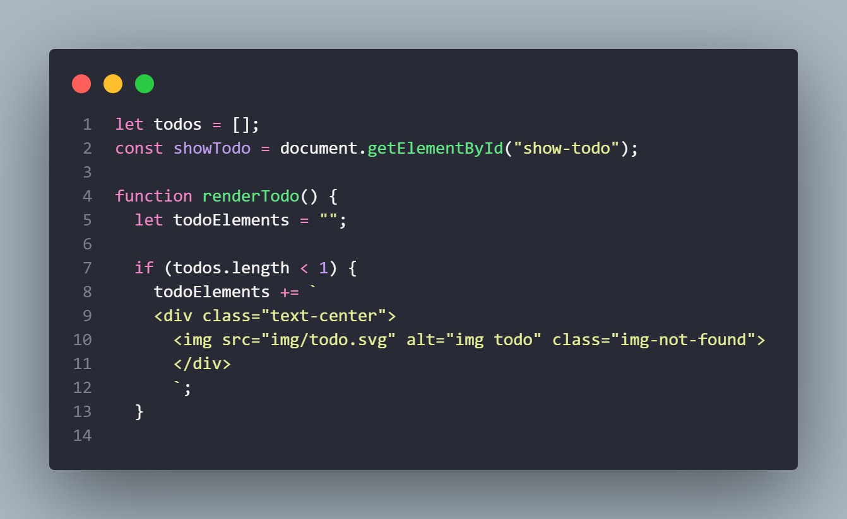
Render

Slide 17
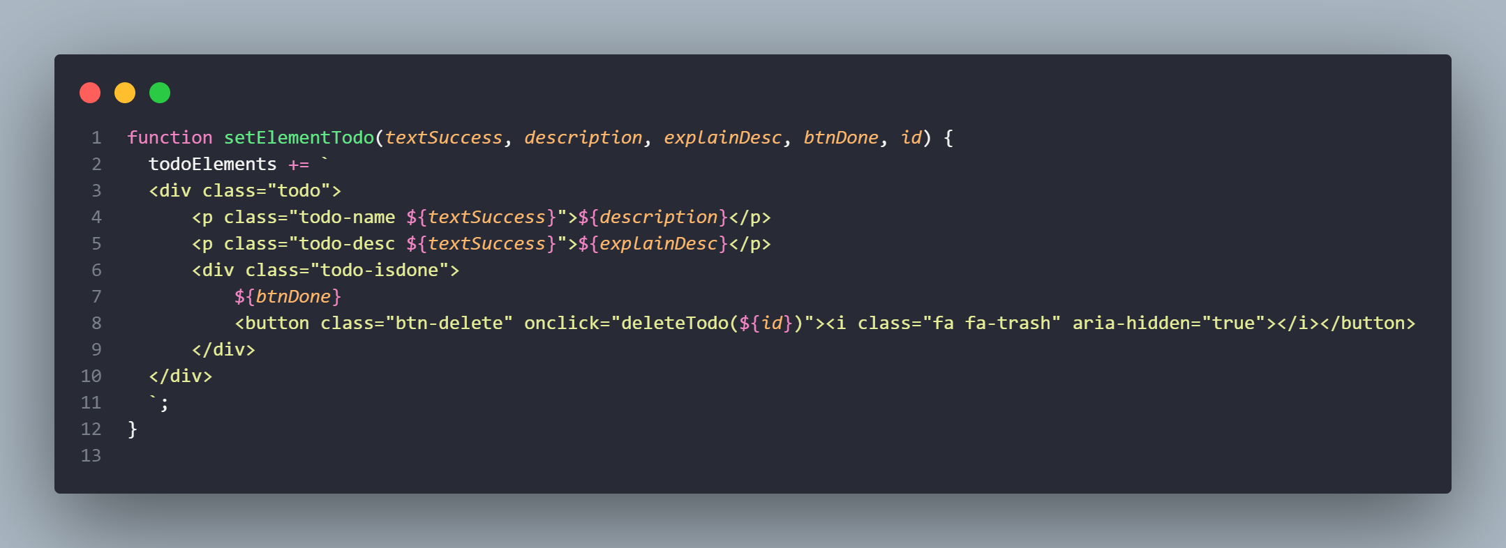
setElementTodo

Slide 18
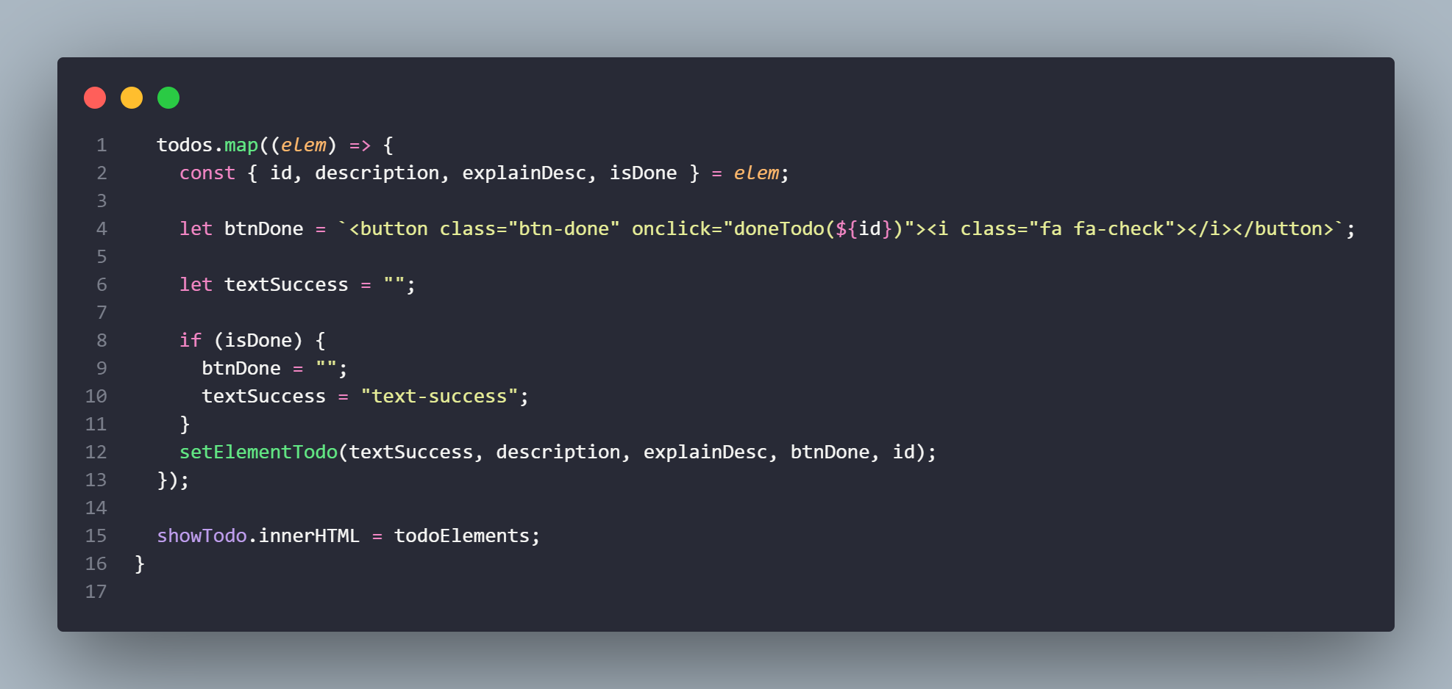
HOF and Callback

Slide 19
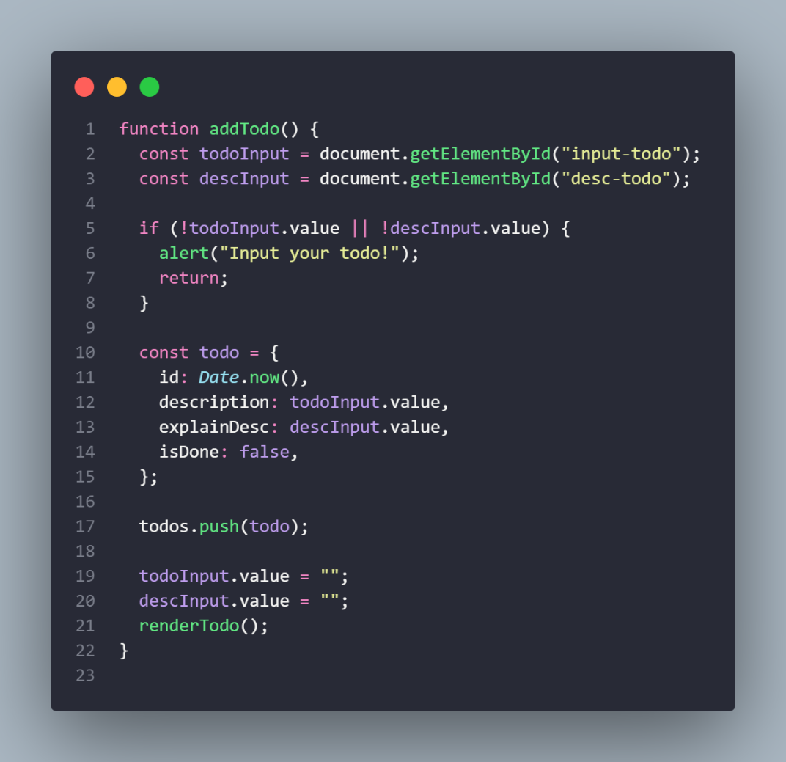
Add todo

Slide 20
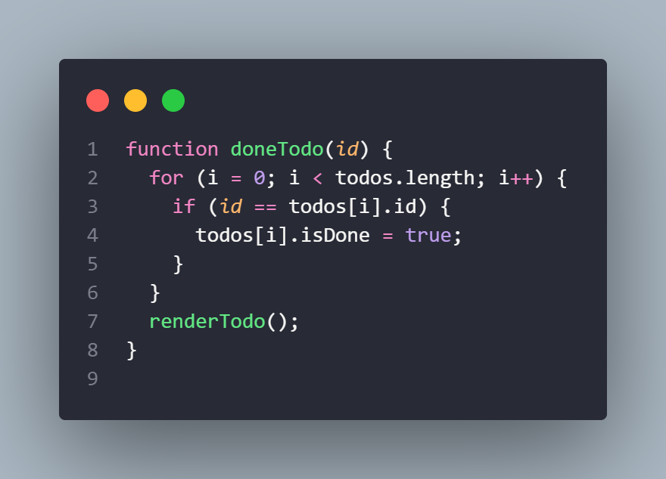
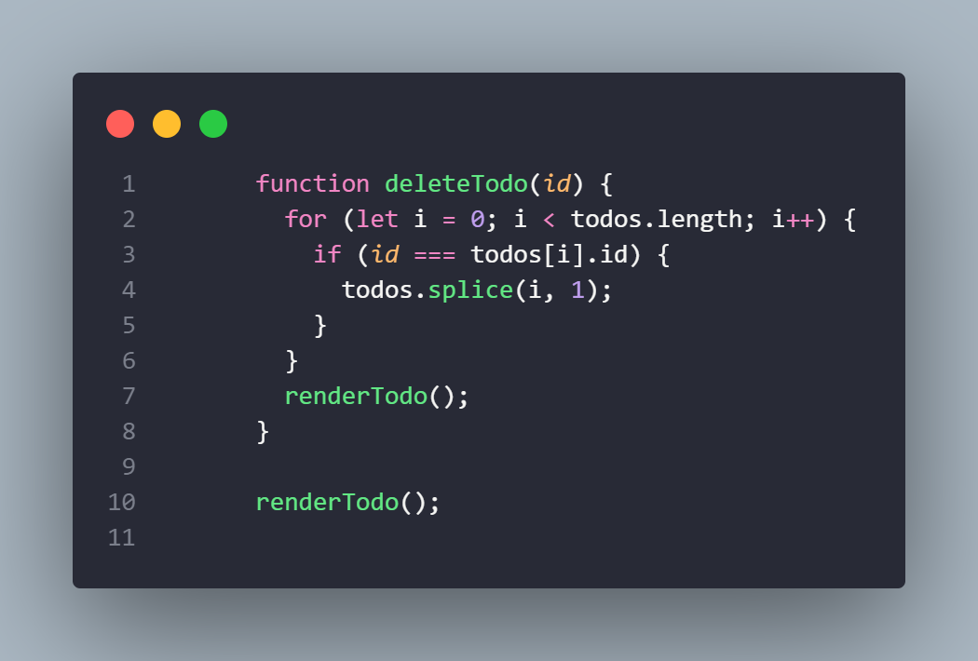
Done and delete todo

Slide 21
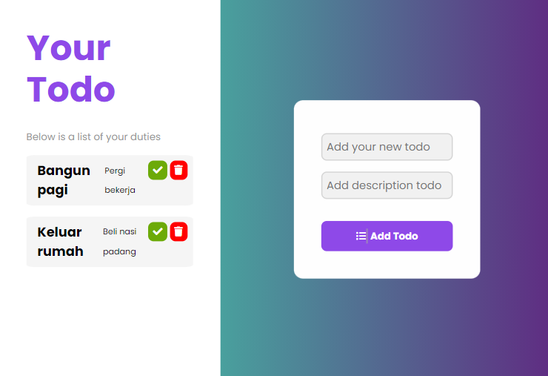
Welcome!!
Insert the title of your subtitle Here
This PowerPoint Template has clean and neutral design that can be adapted to any content and meets various market segments.

Slide 22
Asynchronous

Slide 23
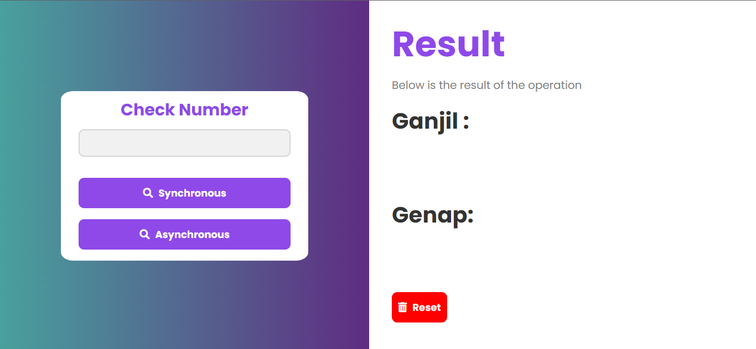
Welcome!!
Insert the title of your subtitle Here
This PowerPoint Template has clean and neutral design that can be adapted to any content and meets various market segments.

Slide 24
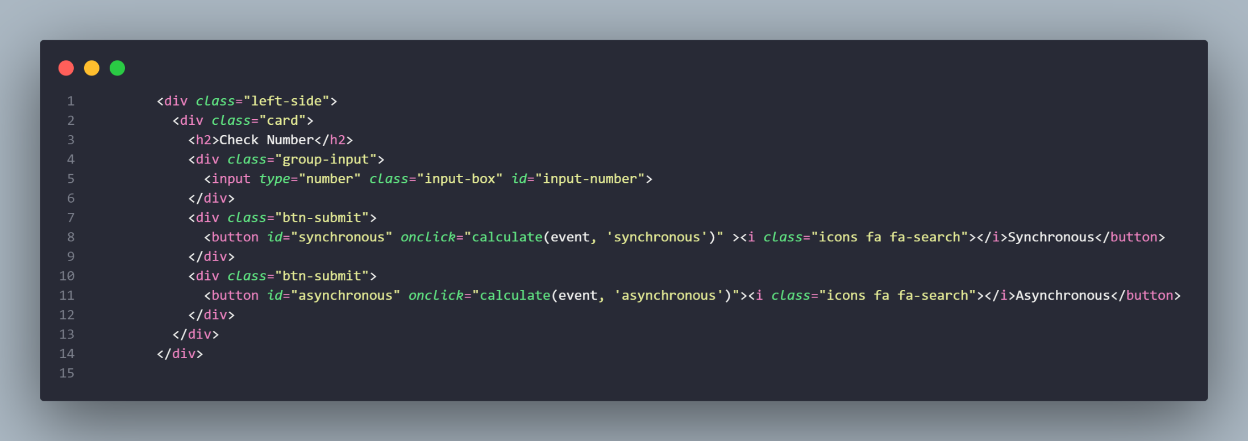
HTML

Slide 25
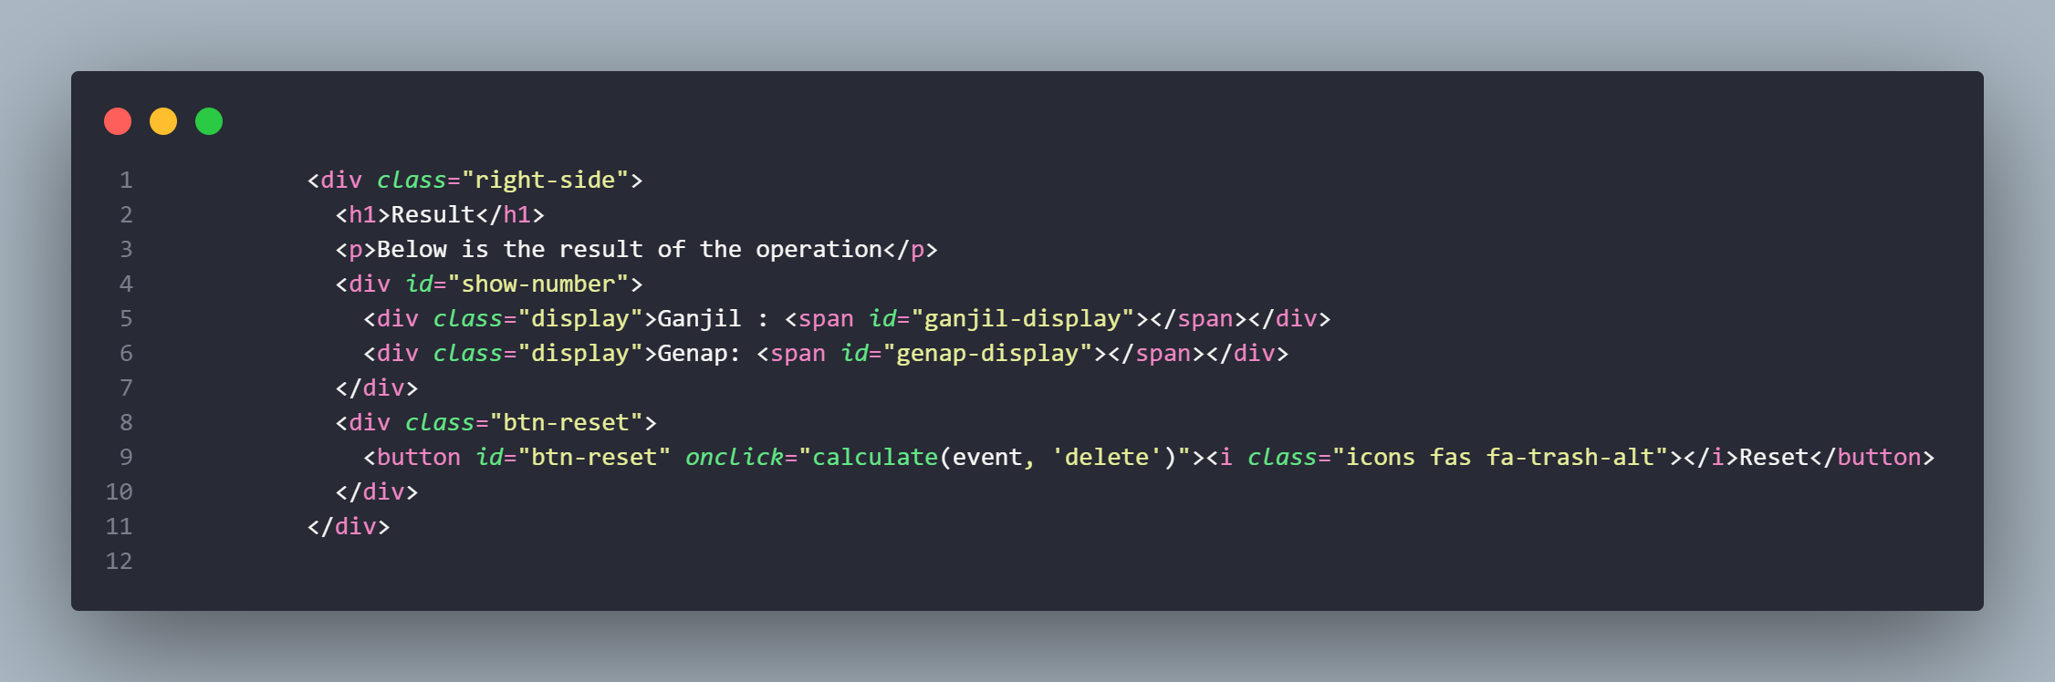
HTML (2)

Slide 26
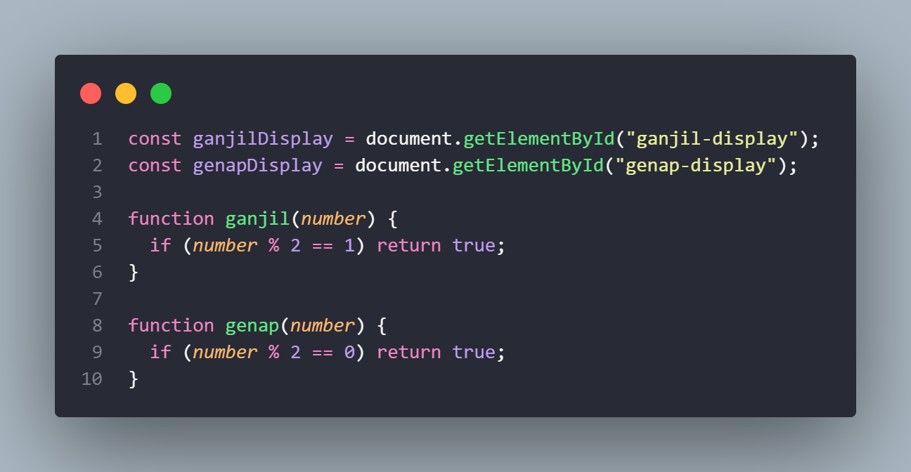
Select

Slide 27
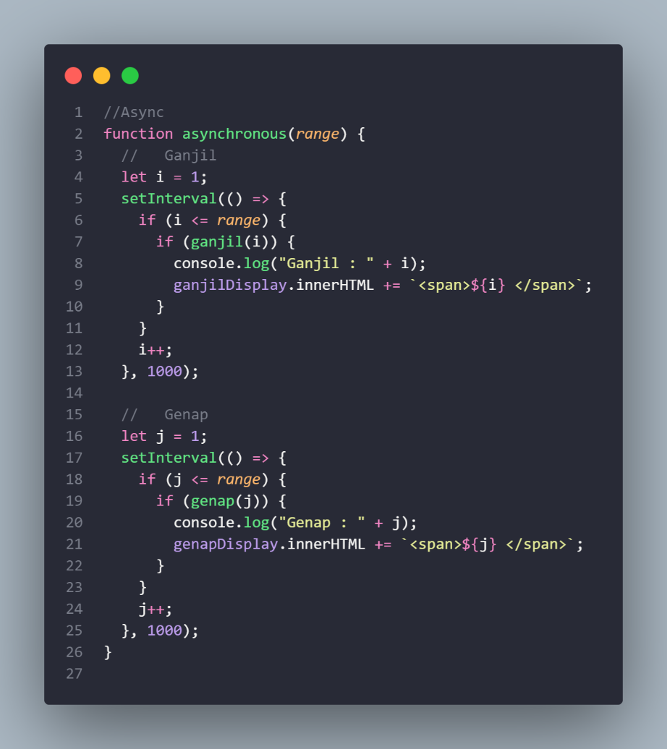
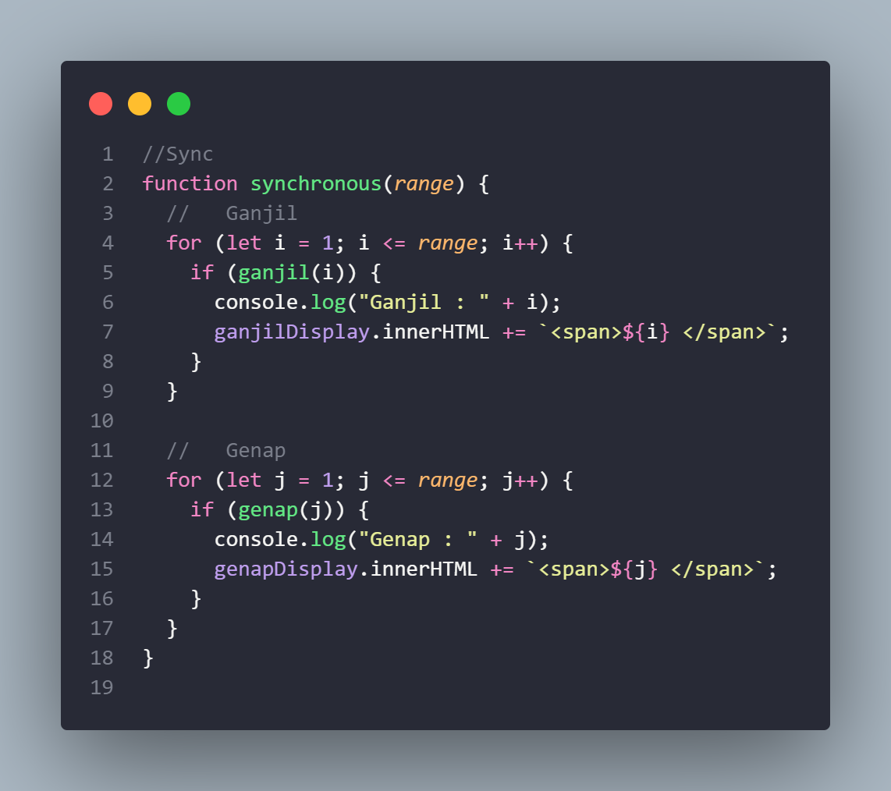
Asynchronous and Synchronous

Slide 28
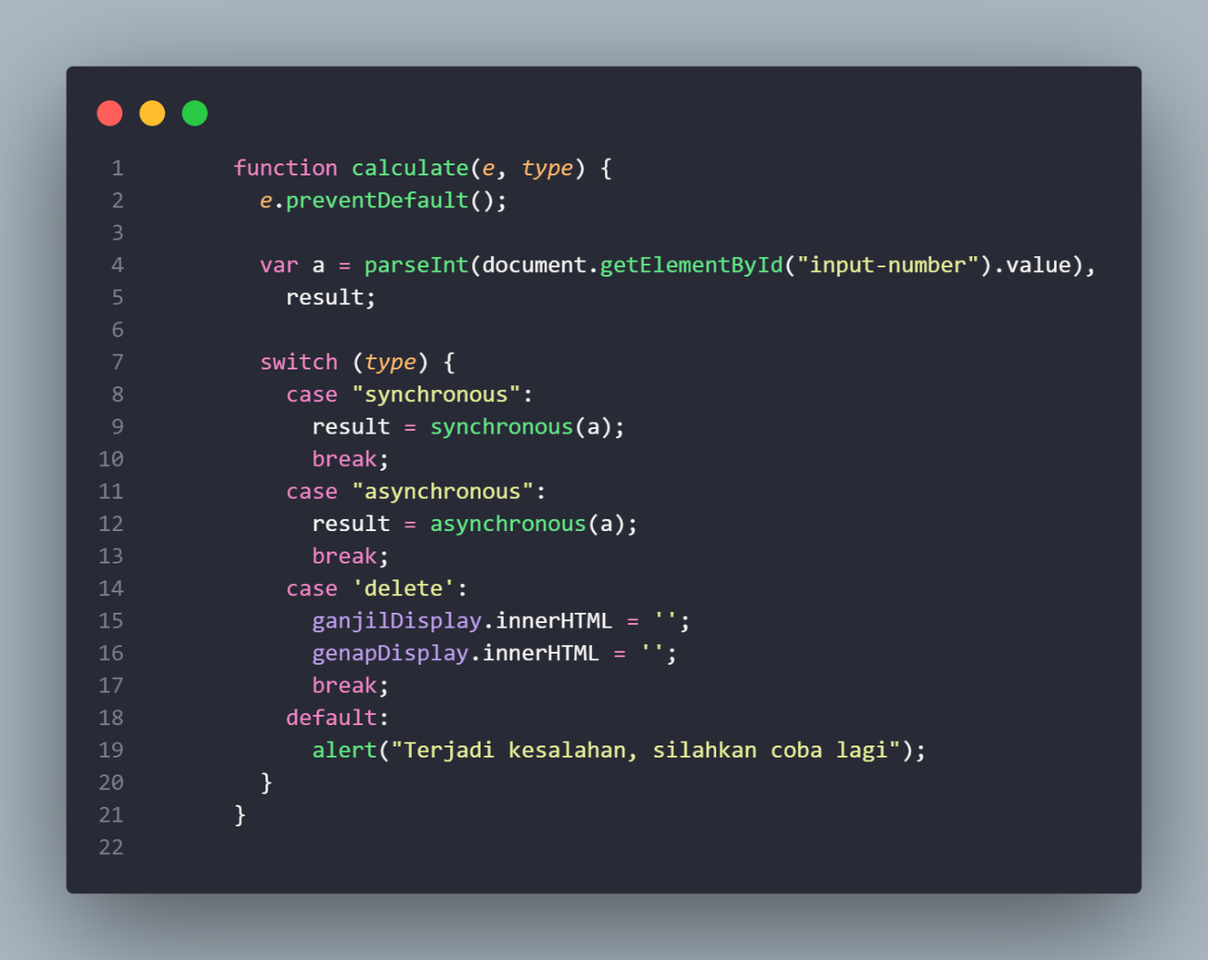
Calculate

Slide 29
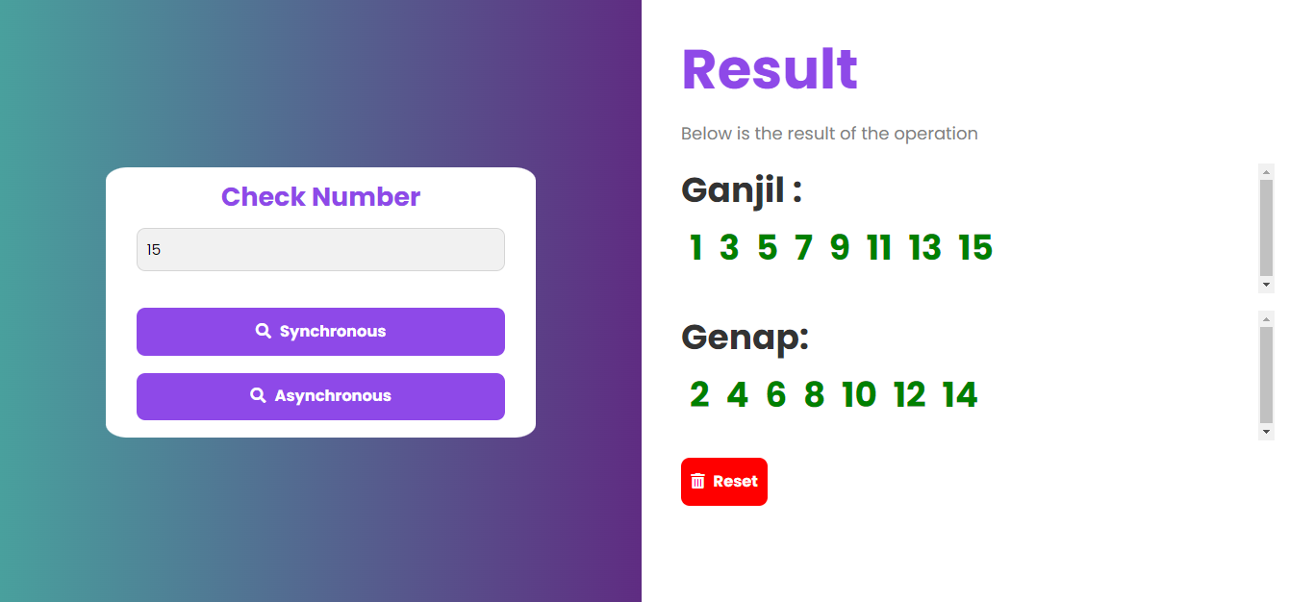
Welcome!!
Insert the title of your subtitle Here
This PowerPoint Template has clean and neutral design that can be adapted to any content and meets various market segments.

Slide 30
Thank you
Have a nice day ☺

